Slide 1
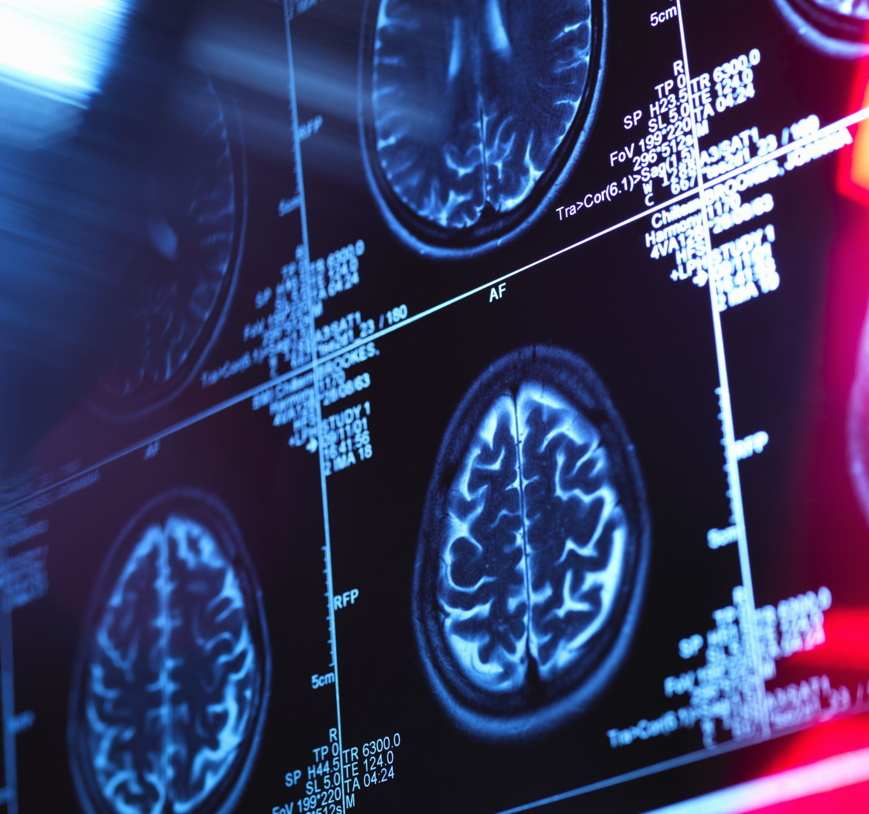
Capabilities of Moustache Detection with High-quality MRI images
Aiden Matthews, Jason Siu, Molly Cullen and Sofia Nightingale
MXB201 – Group 26

Slide 2
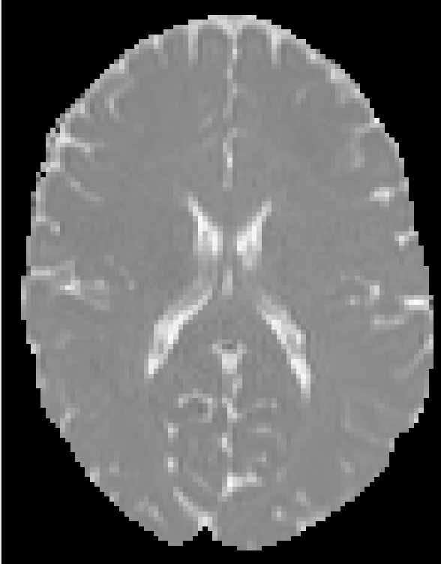
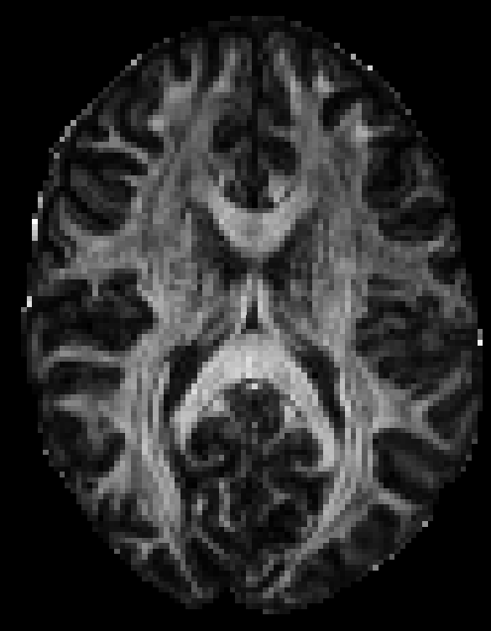
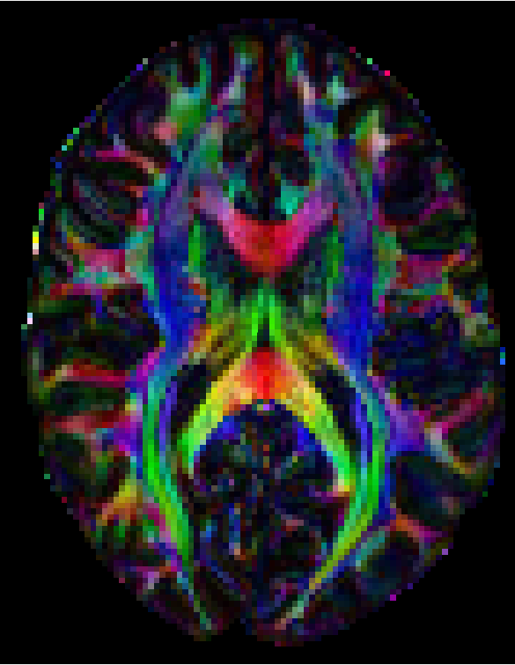
Creating high-quality MRI images
Mean diffusion
Principal diffusion

Slide 3
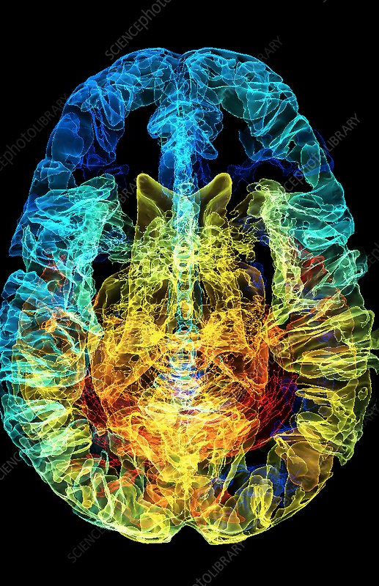
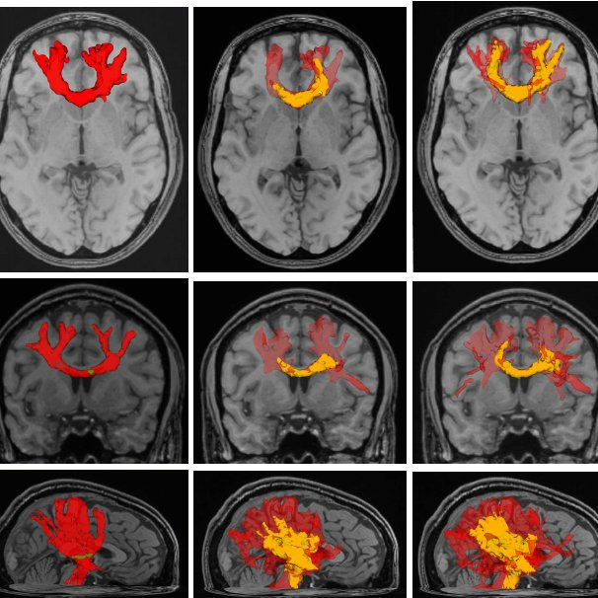
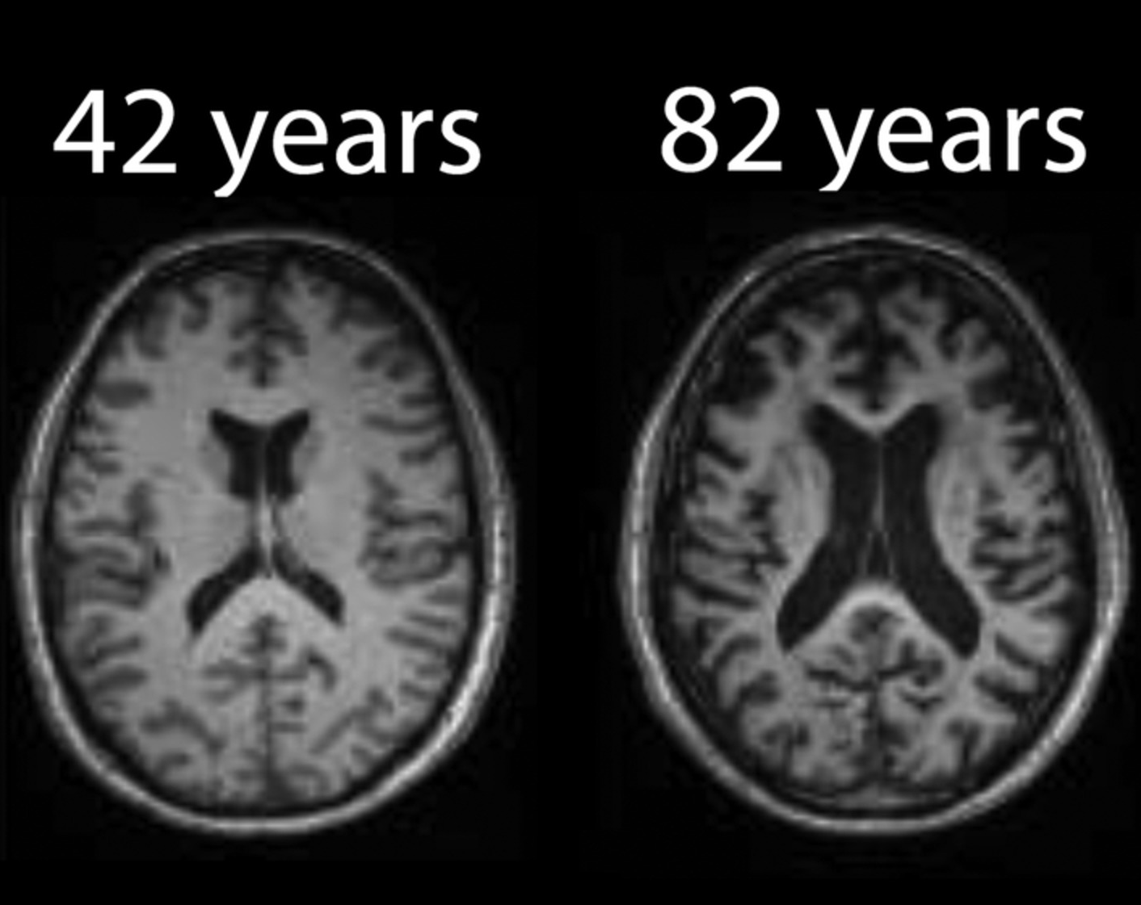
Future uses of this imaging technique

Slide 4
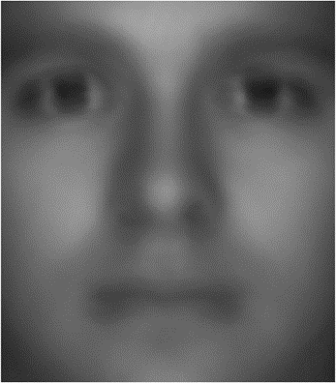
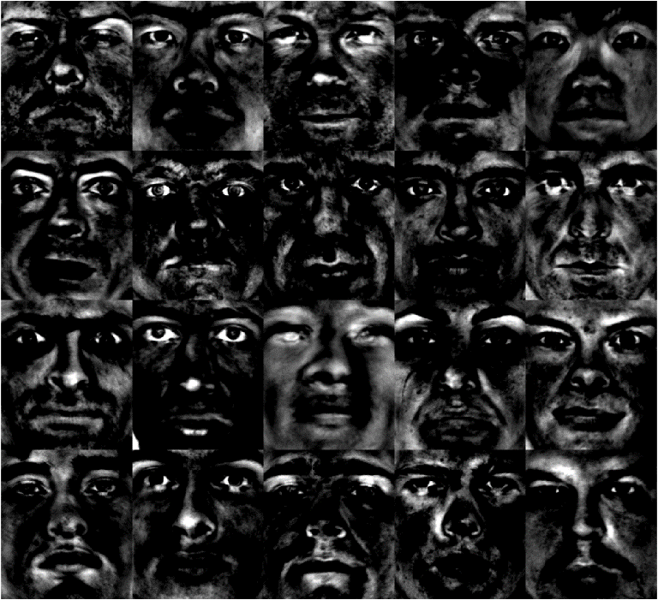
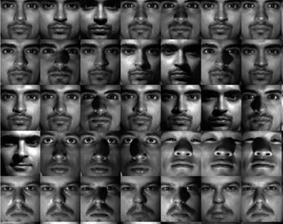
How we detect a moustache
Most unique face ‘ingredients’ aka ‘eigenfaces’
Some faces that are identified to have a moustache
The average face from the data

Slide 5
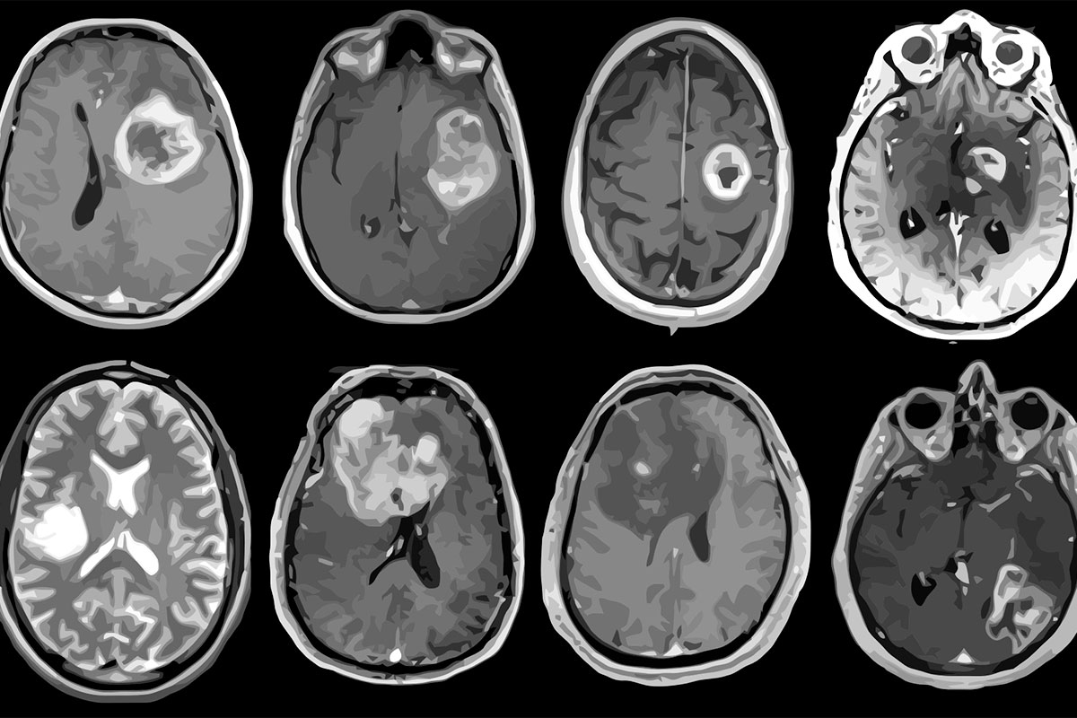
Adapting the detection system to Mri images
What the code currently detects
What the code could detect

Slide 6
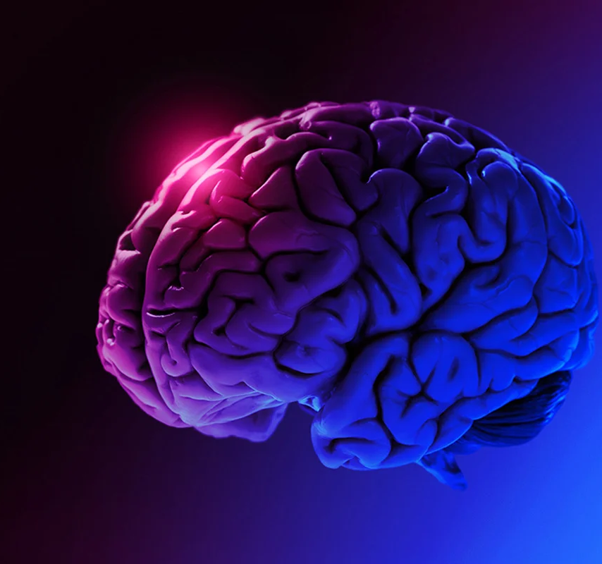
Improve digital health system in reference to MRIs
Thank You

